Slide 1
X-ray Detector Simulation Project using GEANT4 and COMSOL
ANDREW MAIER, AYUB SHERIF, BRADLEY STEINBAUER, MOHAMMED ALSOWAIGH

Slide 2
Outline
Timeline
Objectives/Goals
Introduction
GEANT4 Results
COMSOL Results
Advantages and Disadvantages

Slide 3
Timeline
1- Our first meeting on Zoom 3/8 ( Assigning Tasks)
2- Presenting Preliminary Plan to the class 3/10
3- Research and read about the topic ( week of 3/15)
4- Installing the programs ( week of 3/22)
5- Second meeting 3/28 ( Solving some installation problems)
6- Running the simulations ( week of 3/29)
7- Third meeting 4/10 ( discussing the results and rearrange the tasks)
8- Preparing the final presentation 4/17
9- Submitting the Report 4/23

Slide 4
Objectives/Goals
Initial goals are to learn to develop an understanding of COMSOL and learn how to develop or import CAD models into COMSOL using existing examples.
​
Initial goals for using Geant4 in this project are to install the core libraries and pre-compiled libraries to test example simulations that may be similar to the X-ray particle simulations we are interested in running.
Building up a deep understanding about how radiation simulations work and being familiar with.

Slide 5
Introduction
X-ray imaging systems have been widely used in the fields of medical and industrial applications.
Great efforts also have been made for improving of detection systems and optimum design conditions of operating components e.g.
X-ray sources, detection media
To estimate or improve the system, it is necessary to evaluate the effects of each parameter in the X-ray imaging chain. Done via
individual experiments on each component.
Ahn et al., 2003

Slide 6
Introduction
One can evaluate the system performance in terms of the MTF and DQE using the linear system model.
One of the other methods is the simulation of the imaging system with varying parameters.
From the operation parametric point of view, simulated images, which can be obtained in short time and a simple way, show the effects of each component in the system in visual.
Rossi et al., 2000

Slide 7
Introduction
In this project, GEANT4 and COMSOL were used to run a basic simulation of X-ray interaction with a single cell semiconductor sensor.
CAD was used to assist in creating the model.
Also, existing open source GEANT4 applications were used with the GEANT4 simulation with the single pixel sensor.

Slide 8
Introduction
COMSOL is a cross-platform finite element analysis, solver and multiphysics simulation software. It allows conventional physics-based user interfaces and coupled systems of partial differential equations.
Running basic physics simulations with a rudimentary model. These basic simulations will eventually be scaled up as the project progresses.​

Slide 9
Introduction
GEANT4 is a platform for the simulation of the passage of particles through matter using Monte Carlo methods.
CCD Pixel models are 4096 by 4096 pixel, if we try to do that for this project, it will take a considerable amount of time to run a single simulation and that will not be a good idea. The goal of this project is not really to complete an entire simulation but to show a proof of concept on how GEANT4 and COMSOL work.

Slide 10
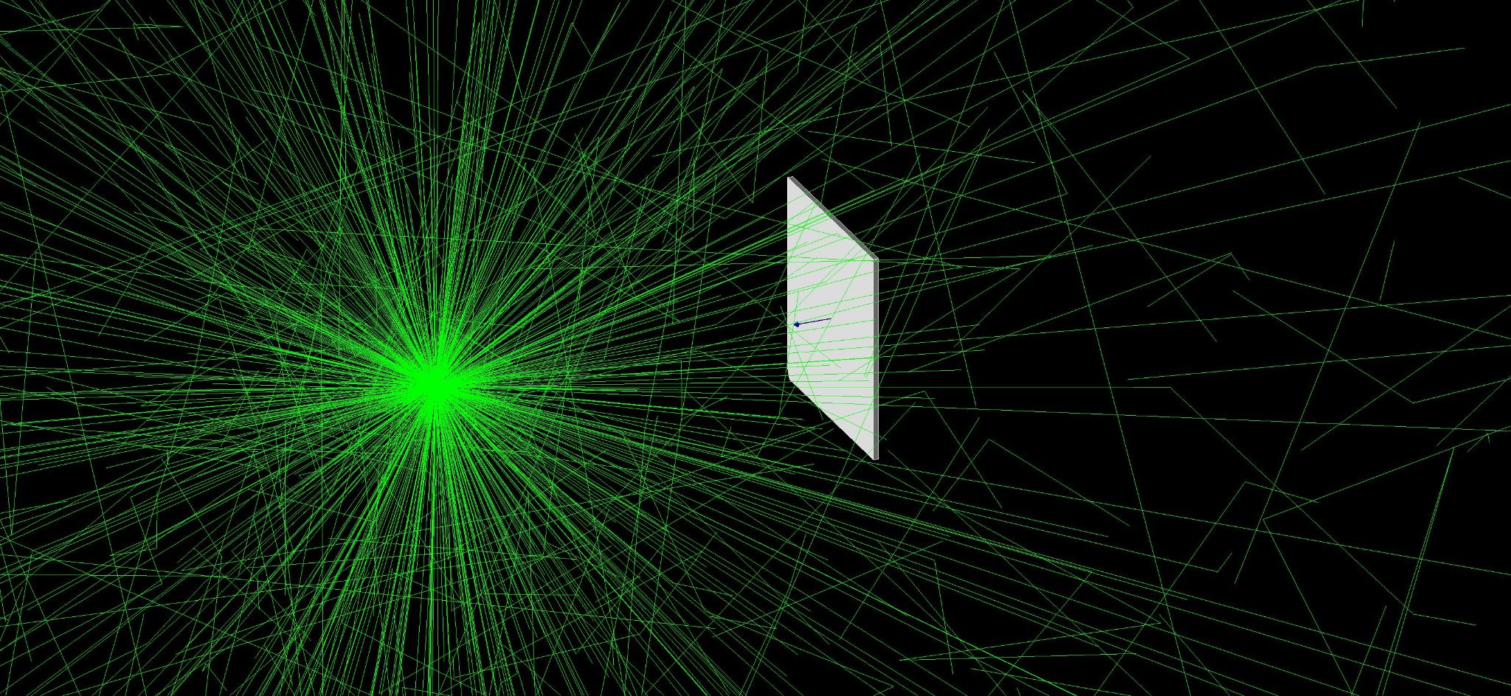
GEANT4 - TestEm4 Example
TestEm4 is a built-in example, allows for the simulation of gamma rays with a detector.
Requires the detector to be defined in C++, which is more difficult to use than a text-defined geometry.
Tests were run with a 4in x 4in x 0.1in silicon detector plate.
The detector construction consists of an 8000 cubic meter cube of air containing the detector plate.
Point source of 100 keV gammas only emits in all directions, not as a focused beam towards the detector.
Notes:
The Geant4 simulation consisted of learning basic detector construction, particle selection from pre-compiled or imported physics lists, and running simple low-energy gamma ray events (X-rays) with basics detector geometries and material geometries. Because of the steep learning curve associated with Geant4, two pre-existing applications were used; TestEm4, a built-in example, and GEARS, a compact, fully-features Geant4 application developed by Dr. Jing Liu of the University of South Dakota.
Simulations run in TestEm4 required the detector to be constructed as a C++ object. One geometry used consisted of a block of silicon with dimensions 4in x 4in x 0.1in in an 8,000 cubic meter cube containing air. A point source emitting 100keV gammas was plated 25 cm from one face of the detector plate, and up to 100 events were run to observe particle tracks.
This method of modifying TestEm4 has some severe limitations. The detector geometry is defined in C++, which is difficult to use and requires full recompilation if a change to the geometry needs to be made.
This example did, however, provide a simple application to help us understand particle track visualization with simple geometries, and definitions of materials using known elements.
GEARS is a very compact and fully-featured Geant4 application available under the MIT license. The same geometry detector was made using an ASCII markup style that allows for simple geometries to be loaded into GEARS while the program is running. This doesn’t require recompilation. A point source emitting 100keV gammas was placed 1 meter from the face of the detector plate, and 100 events were run for visualization purposes. The visualizer can also be turned off to run many thousands of events; one simulation saw 50,000 events run. The results from this simulation were then analyzed in ROOT, allowing for analysis of energy deposition in the detector plate.

Slide 11
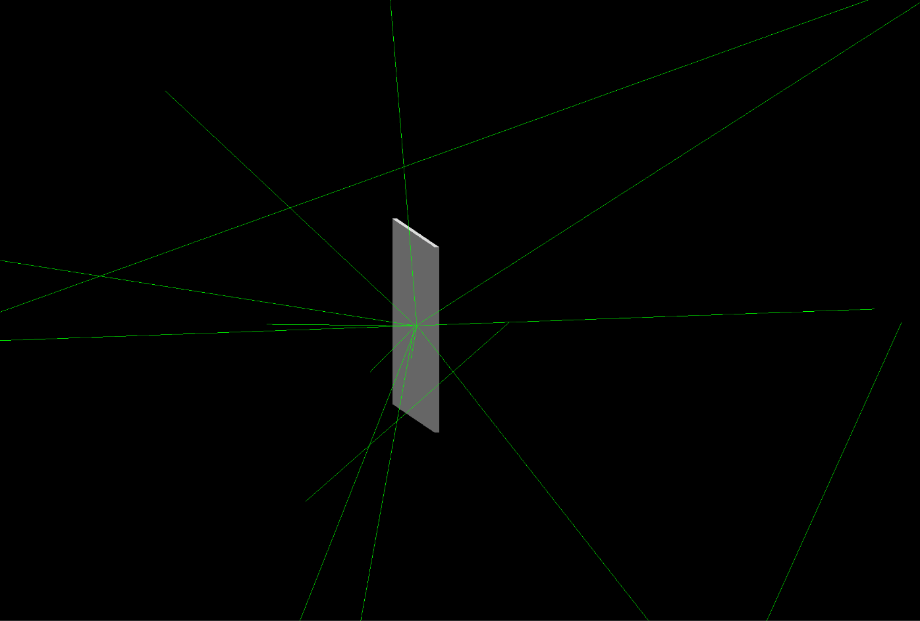
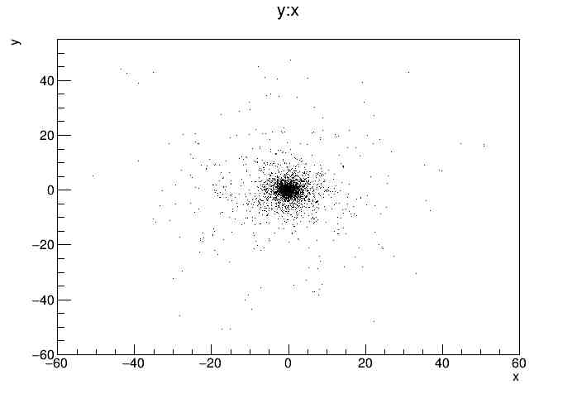
GEANT4 - GEARS Open Source Application
GEARS is a compact, fully featured open-source GEANT4 application developed by Dr. Jing Liu of the University of South Dakota.
GEARS allows for the importation of geometries, no recompilation necessary.
Gammas are low energy (100 keV) from a point source.
Results can be output to ROOT for analysis.
Disabling visualization allows for faster simulations.
Geometries were defined in ASCII .tg files and imported, allowing for quick changes.
50,000 events can be run within seconds.

Slide 12
Comsol Simulation Purpose
•The purpose of using comsol was to obtain a better understanding of how x-rays would affect a simple pixel design.
•This was done coupling both the semiconductor and electromagnetics wave frequency domain modules. This coupling is often used for simulating optoelectronic devices such as solar cells and photodiodes.

Slide 13
Comsol Parameters
•For comsol simulations, a simplified version of a pixel was used.
•The whole pixel has a background p-type doping of 1x10^14 cm^-3 (number of atoms per cubic centimeter) with 1x10^18 cm^-3 n-type doping defused on the top left of the model.
•Two volts were applied to the p-region and a ground was connected to the n-region.
•The intensity of the incident radiation was at a constant 10 Watts.

Slide 14
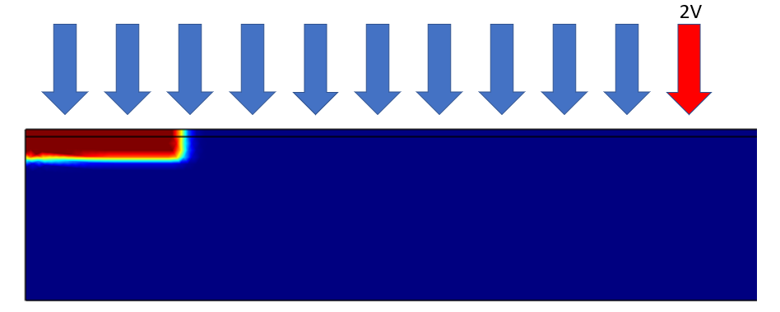
Comsol Results
•The doping profile is shown below. The arrows show the direction of incident radiation The blue region is p-doped and the red region is n-doped. With this setup we are essentially simulating a forward biased PN junction.

Slide 15
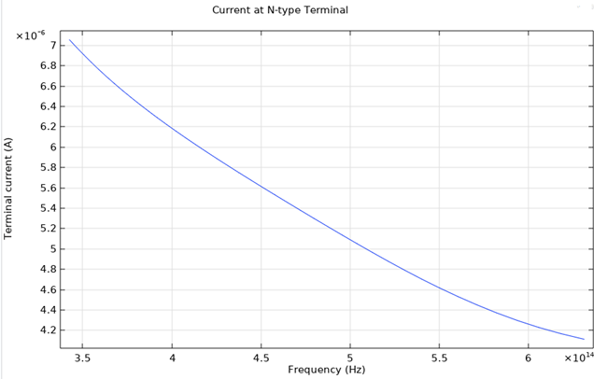
Comsol Results Continued
•The following graph shows how current across the PN interface varies with the frequency of incident light.

Slide 16
Advantages and Disadvantages
For GEANT4:
Ability to track particles in many different situations
Many open-source GEANT4 applications available
Geometries defined in C++ not flexible
Very steep learning curve
For COMSOL:
Relatively easier
Showing the equations
Advanced
Restrictive Licensing

Slide 17
Reference
[1] S.K. Ahn et al., " A computer code for the simulation of X-ray imaging systems," 2003 IEEE Nuclear Science Symposium. Conference Record (IEEE Cat. No.03CH37515), Portland, OR, USA, 2003, pp. 641-642 Vol.1.
[2] M. Rossi, F. Casali, S. V. Golovkin, V. N. Govorun, Digital radiography using an EBCCD based imaging device, Appl. Radiation and Isotopes 53 (2000) 699-709

